Slide 1
A Pastoral Framework for Studying British Nature Writing
Terry Gifford
Bath Spa University
University of Alicante
www.terrygifford.co.uk
terrygifford@gmail.com

Slide 2
‘Nature Writing’
In the UK this is a 20th century term referring to a body of work.
In its current academic usage it’s from American ecocriticism which began with a focus on Barry Lopez, Edward Abbey, Gary Snyder and Annie Dillard’s Pilgrim at Tinker Creek –
a personal epiphany from engagement with nature.
Lawrence Buell was a Thoreau scholar. Thoreau was influenced by Emerson who invented ‘transcendentalism’ as an American break from European pastoral: idealism rather than idealisation.

Slide 3
British Ecocriticism
Jonathan Bate was unaware of American ecocriticism when he called for ‘a literary ecocriticism’ in Romantic Ecology (1991), as I was also unaware of American ecocriticism in writing Green Voices (1995) where I introduced pastoral theory and the ‘post-pastoral’.
Compare the US’s The Ecocriticism Reader (1996) with UK’s The Green Studies Reader (2000). The latter refers only to American nature writing.

Slide 4
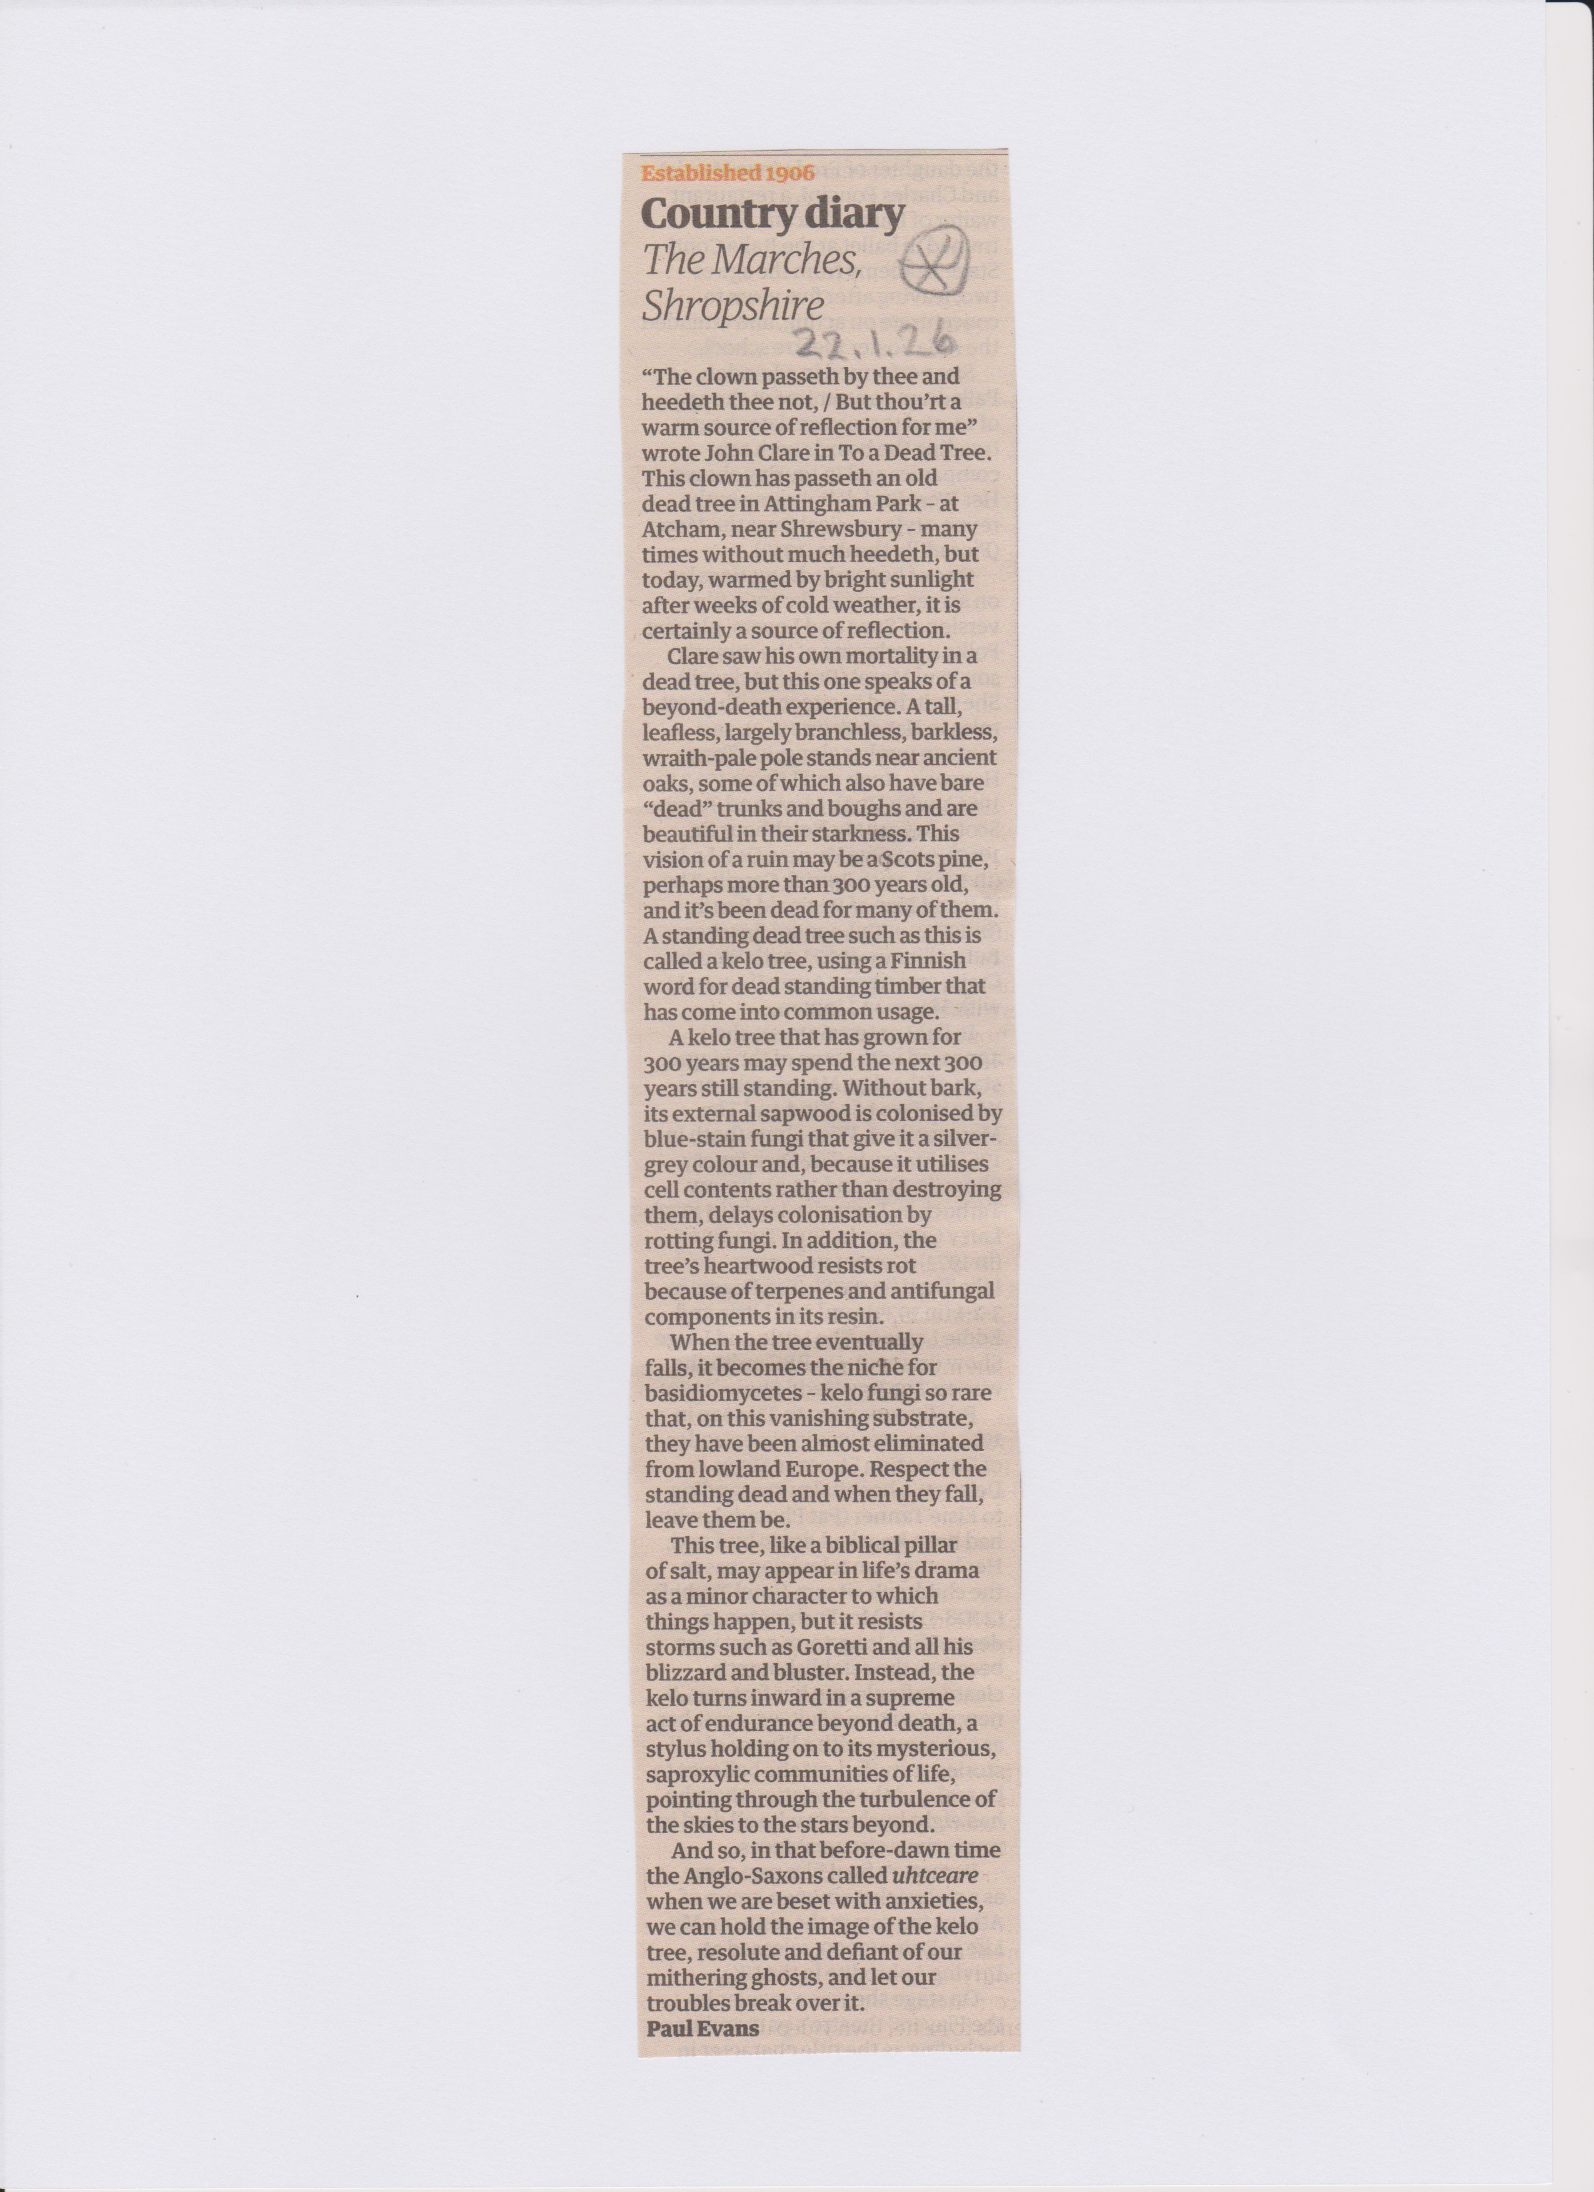

Slide 5
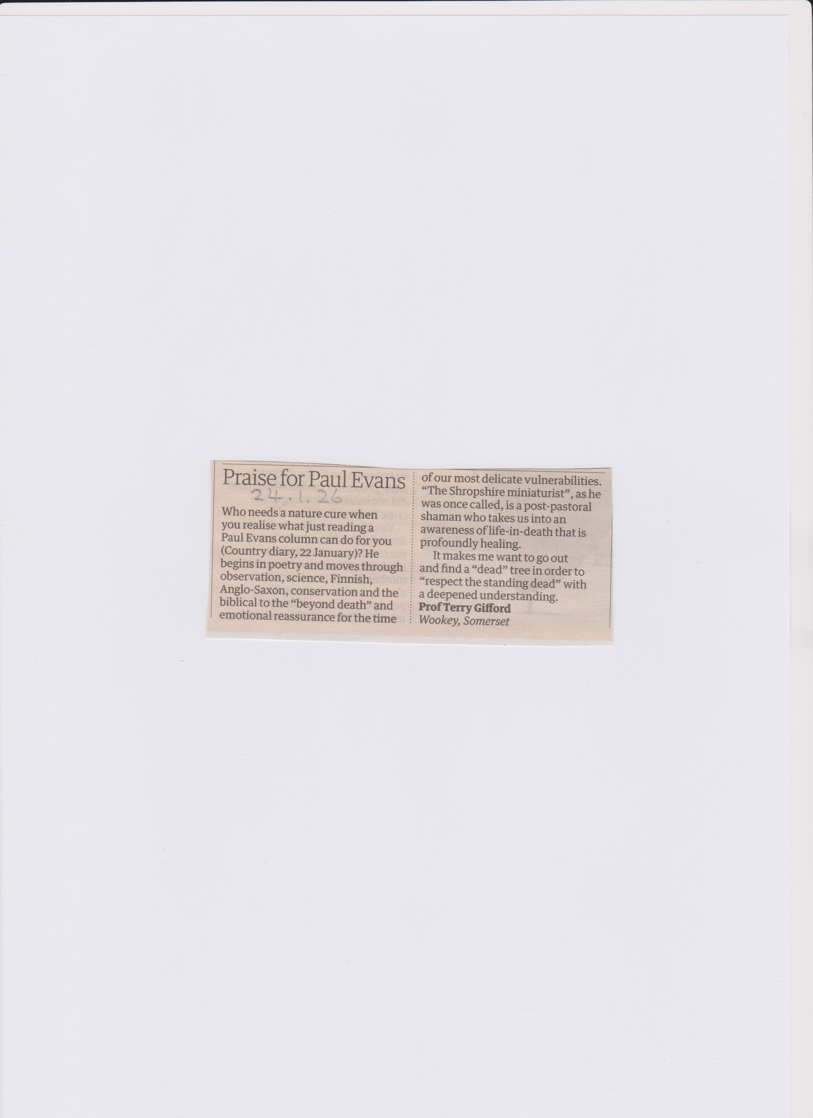

Slide 6
Chris Townsend
There has been increasing understanding of the value of wild places in recent decades. From personal accounts and the popularity of nature writing to social and scientific studies, the evidence for the value of wild land is mounting.

Slide 7
NatureScot 2010
Spending on nature-based tourism contributes 40% of all tourism spend, supporting 39,000 fulltime equivalent jobs.

Slide 8
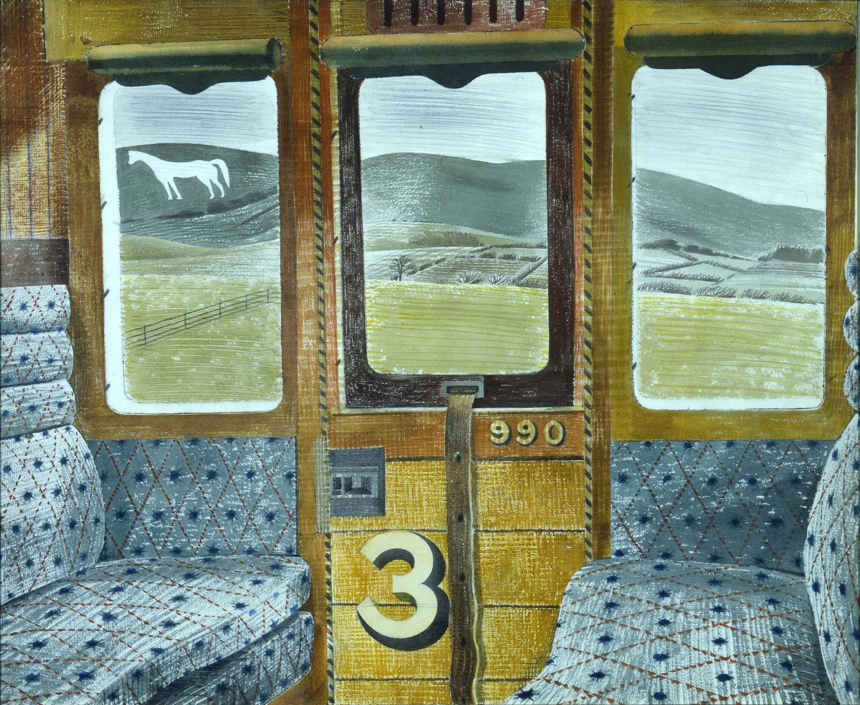
Eric Ravilious ‘Train Landscape’ 1939

Slide 9
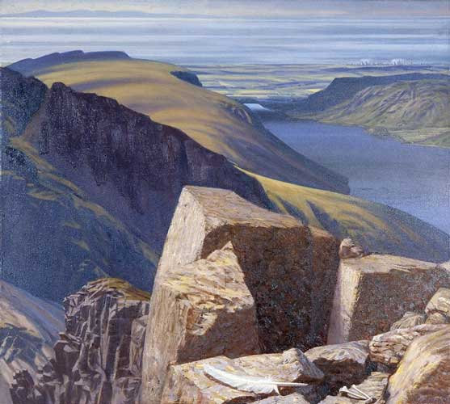
Julian Cooper ‘Towards the Sea, Scafell’ 1988

Slide 10
4 uses of ‘Pastoral’
The classical literary tradition begun in 3rd century BC by the Greek Theocritus in The Idylls, later adapted by the Roman poet Virgil in his Eclogues.
Any literature that describes the countryside in contrast to the court or the city.
Literature about herding animals.
The pejorative sense of idealisation that obscures harsh realities.

Slide 11
Pastoral
Retreat and return
Idealised
Nostalgic
Unproblematic – order, stability, agreed values
Golden Age
Arcadia the literary construct
Eden, Arden, Shangri-La, the West, Fern Hill

Slide 12
Anti-Pastoral
Corrective of pastoral, often explicitly
Unidealised – harsh, unattractive,
Emphasises ‘realism’
Problematic – tensions, disorder, inequalities
Challenges literary constructs as false distortions
Demythologises Arcadia

Slide 13
Post-Pastoral
Texts that ask some or all of the following six questions in any time period:
Can awe in the face of nature lead to humility in our species, reducing our hubris?
What are the implications of recognising that we are part of nature’s creative-destructive processes?
If our inner nature echoes outer nature how can the outer help us understand the inner?
If nature is culture, is culture nature?
How can consciousness, through conscience, help us heal our alienation from our home?
Is the exploitation of our planet aligned with our exploitation of human minorities?

Slide 14
British nature writers timeline
Gilbert White, 1788, The Natural History of Selbourne (opposite of transcendentalism; book)
Richard Jeffries, 1879, The Amateur Poacher
W.H. Hudson, 1909, Afoot in England
Edward Thomas, 1906, The South Country
H.V. Morton, 1927, In Search of England
Jacquetta Hawkes, 1951, A Land
J.A. Baker, 1967, The Peregrine
Kenneth Allsop, 1972, In the Country
Richard Mabey, 1974, Food for Free
Nan Shepherd, 1977, The Living Mountain
Kathleen Jamie, 2005, Findings
Tim Dee, 2014, Four Fields
Richard Kerridge, 2014, Cold Blood
Helen Macdonald, 2015, H is for Hawk
Paul Evans, 2015, Field Notes From the Edge
Merryn Glover, 2023, The Hidden Fires
Robert Macfarlane, 2025, Is a River Alive?
Amanda Tuke, 2026, Wild Pavements

Slide 15
1960-1980
1960, Gavin Maxwell, Ring of Bright Water
1962 Rachel Carson, Silent Spring
1963 E.P. Odum, Ecology: The Link Between the Natural and the Social Sciences
1963 Derek Ratcliffe, ‘The Status of the Peregrine in GB’
1968 Paul Ehrlich, The Population Bomb
1972 UN Human Environment Report
1972 Kenneth Allsop, In the Country
1972 The Club of Rome, Limits to Growth
1973 Arne Naess, ‘deep ecology’
1976 Richard Dawkins, The Selfish Gene
1977 UK Department of Environment
1979 James Lovelock, Gaia
1980 Marian Shoard, The Theft of the Countryside
1980 Richard Mabey, The Common Ground

Slide 16
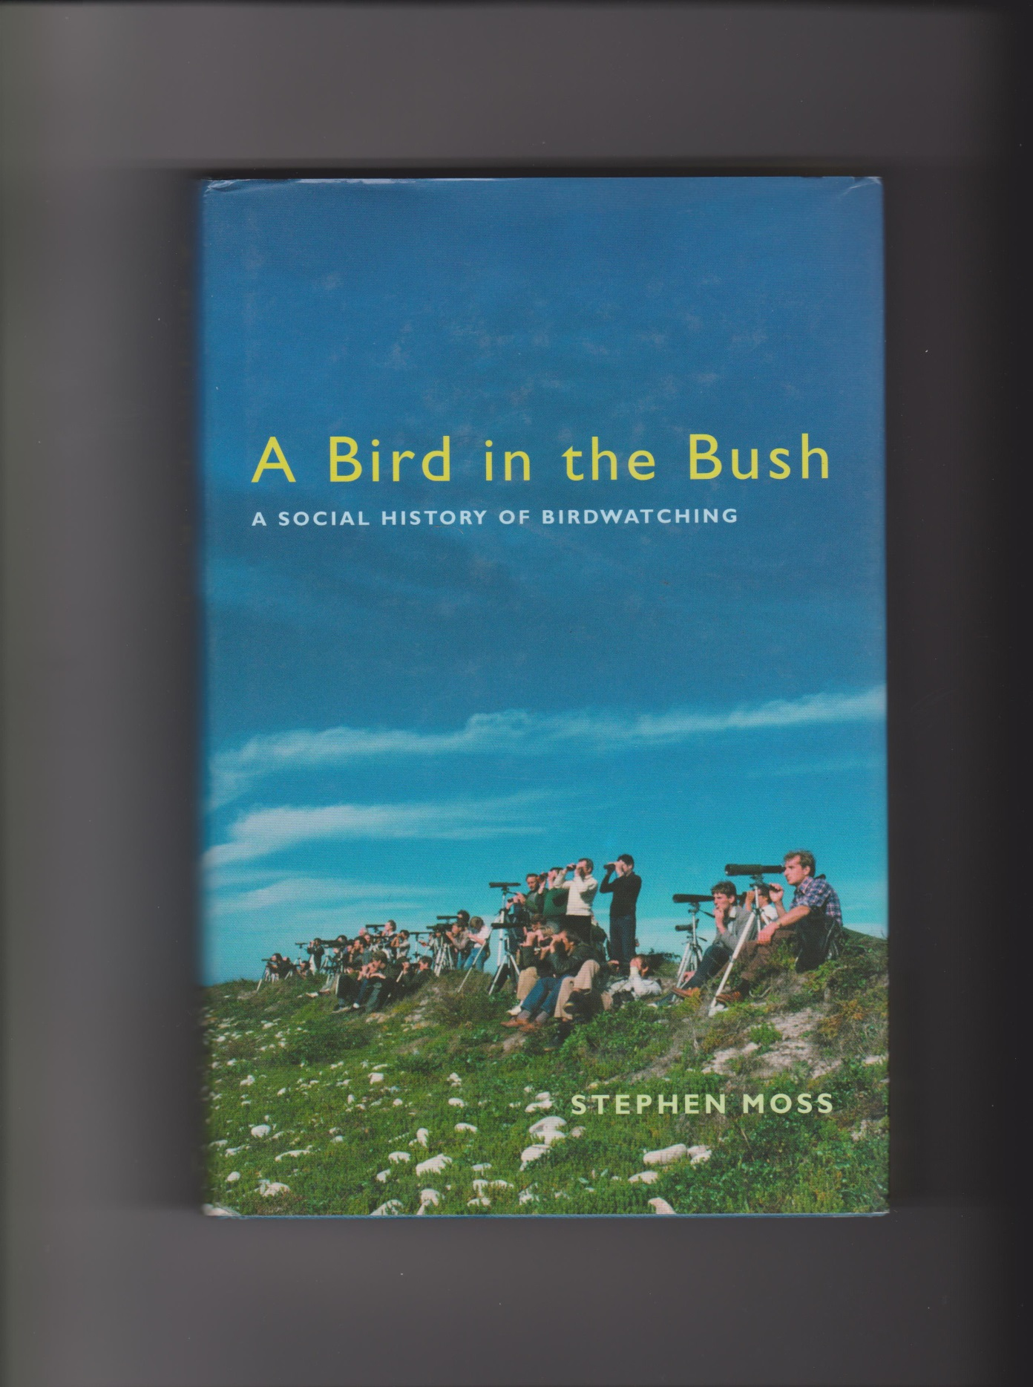

Slide 17
H.V. Morton, In Search of England (1927)
‘History proves to us that a nation cannot live by its town alone: it tells us that the virile and progressive nation is that which can keep pace with the modern industrial world and at the same time support a contented and flourishing peasantry.’ (xi)
H.V. Morton, England (1975)
‘… those things which men break their hearts upon [materialism] are not worth so much in the long run as the sight of the moon tangled up in the boughs of a young birch wood. Heresy, of course!’ (48)

Slide 18
Jacquetta Hawkes, A Land (1951)
‘[…] cutting-edge science and first person-narrative […] It’s for this reason that I proposed A Land to be a missing link. It stands, with Rachel Carson and company, at the beginnings of what is now uneasily known as “environmental writing”: ecologically literate, ethically minded and politically explicit work.’ Robert Macfarlane, ‘Foreword’, 2012 (xxiv)

Slide 19
Jacquetta Hawkes, A Land (1951)
‘The urban masses, having lost all the traditions I have just named which together make up the inheritance which may be called culture, tended to become, as individuals, cultureless.’ (186-7)
‘The people of this island should put their hearts, their hands, and all the spare energy that science has given them into the restoration of their country.’ (201)

Slide 20
Richard Mabey, The Common Ground: A Place for Nature in Britain’s Future (1980)
Nature Conservancy Council – science and conservation
Nature as culture (‘place’ not ‘habitat’)
Recognises traditional ‘cultural history’ as evolving
John Clare and Annie Dillard quoted
Biosphere: science, ethics, value, meaning
Human choices beyond scientific criteria
Nature conservation is human conservation
‘Common species keep the living world ticking’
From local to global: ‘parochial histories’; ‘place, process’
Museum nature or dynamic continuity and change?
‘Past Harmonies/Present Discord’; ‘Towards a Land-Use Policy’
Beyond ‘sickly pastoral longings’

Slide 21
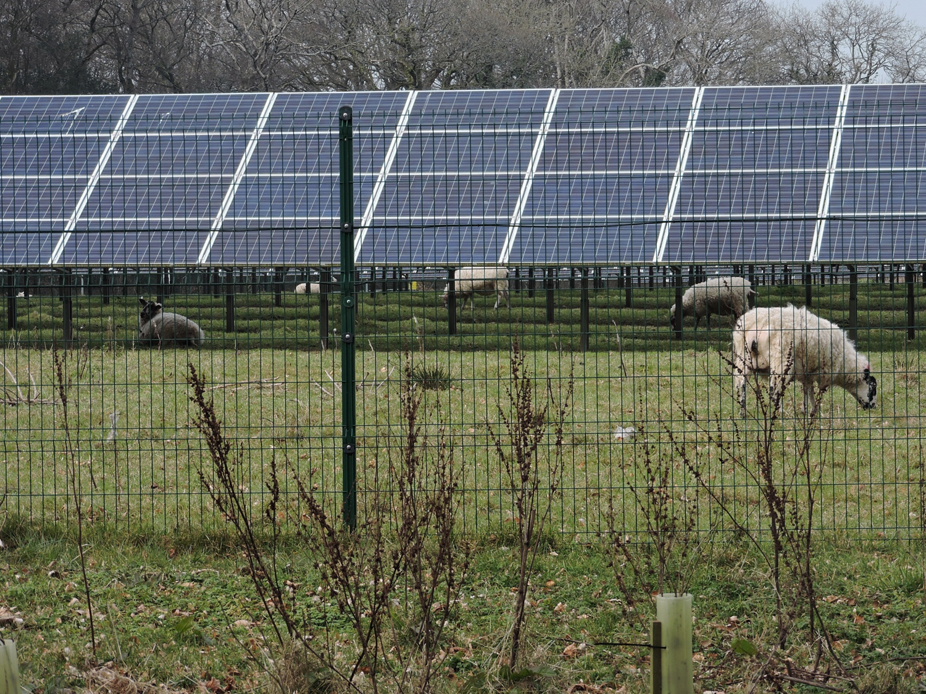

Slide 22
Editorial for Green Letters 17.1 (2013)
Twentieth Century Nature Writing in Britain and Ireland
What exactly was new about the nature writing in Granta’s 2008 collection titled The New Nature Writing? One answer would be ‘not much’. Apart from Kathleen Jamie’s ‘Pathologies: A startling tour of our bodies’ much of the remaining writing followed a familiar pattern of the sensitive and informed individual’s encounter with nature. But this might be the response from a reader familiar with twentieth century American nature writing. As several contributors to this issue discuss, in Britain and Ireland there has been a rather different tradition of nature writing – less spiritual and more concerned with natural history, perhaps: less internally and more externally focused. Yet recent British nature writers such as Robert Macfarlane are also clearly drawing upon the American tradition, as indicated in his interview in this issue. Another answer might be to remark upon the fact that Granta’s editor, Jason Cowley, found this writing to be new. British nature writing – archipelagic literature, bio-geography, bio-psychogeography and various newly named ‘sub-genres' – has been thriving in recent decades.

Slide 23
Post-Pastoral ‘New Nature Writing’
Richard Kerridge, Cold Blood (2014)
Paul Evans, Field Notes from the Edge (2015)
Mark Cocker, Our Place: Can we save Britain’s wildlife before it’s too late? (2018)
Helen Jukes, A Honeybee Heart has Five Openings (2018)
Isabella Tree, Wilding (2019)
Gail Simmons, The Country of Larks (2019)
Stephen Moss, The Accidental Countryside (2020)
Robert Macfarlane, Is a River Alive? (2025)
Amanda Juke, Wild Pavements (2026)

Slide 24
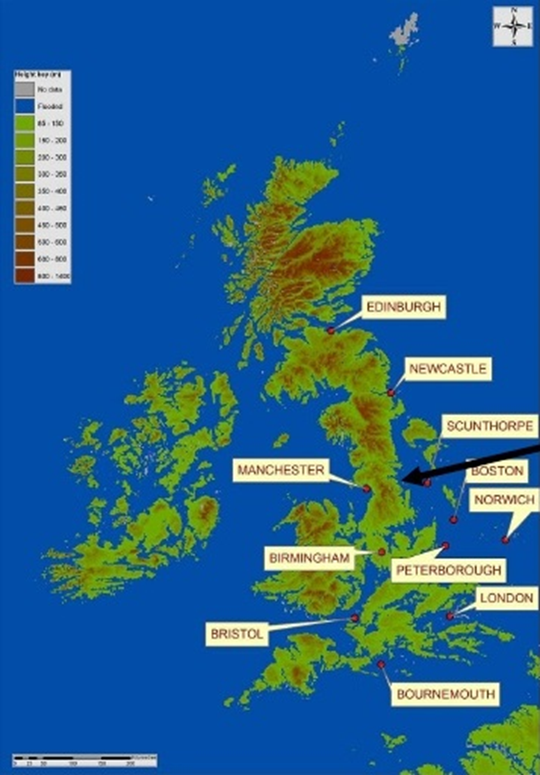

Slide 25
Critiques of ‘New Nature Writing’
Richard Smyth, ‘Plashy Fens: the limitations of nature writing’, Times Literary Supplement, 8 May 2015.
Mark Cocker, ‘Death of the naturalist: Why is the “new nature writing” so tame’?, New Statesman, 17 June 2015.

Slide 26
Some issues in current nature writing
To what extent is The Salt Path nature writing?
Is the nature cure memoir, after Richard Maybe and H is for Hawk, really a rather prurient curiosity into the depression of others for most readers?
Is Is a River Alive? the most important question to ask during a climate crisis?
Is the politically engaged and direct approach of Mark Avery what is needed?
Are we beyond the need for tuning readers into nature?
What is the source of your scientific information?
How does nature writing engage with adaptions?
What is the most influential/most interesting/most useful/best blog?
Should 'nature writing' draw upon and include fiction and poetry?

Slide 27
As Theocritus himself put it in The Idylls (3rd century BC),
‘No one can be saved by ignorance when the thread
Unwinds on the fateful bobbin’ (124).

Slide 28
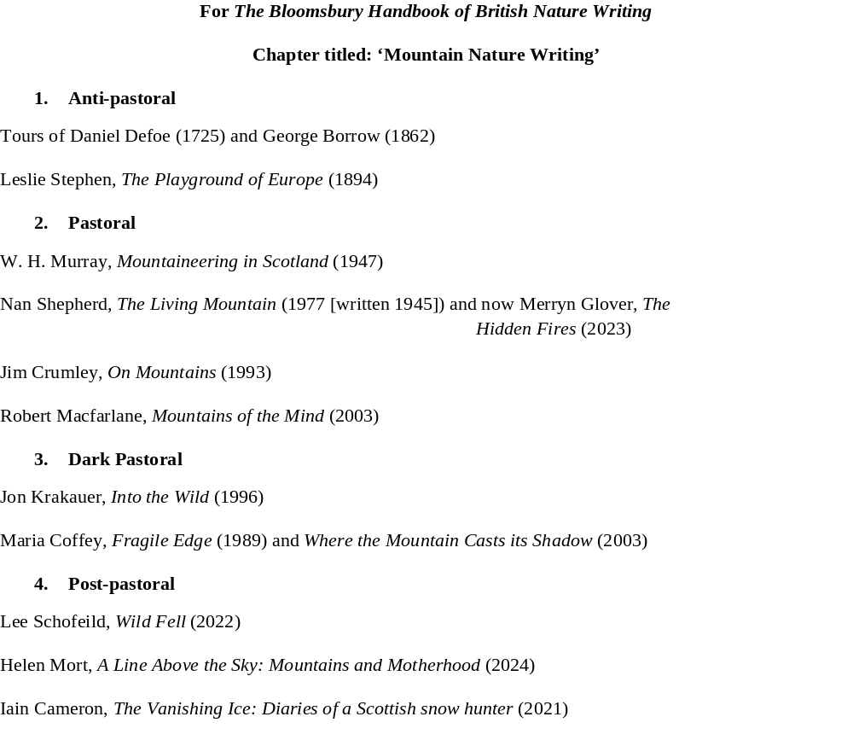

Slide 29
Further Reading
Abberley, Will, et al (2022). Modern British Nature Writing, 1789-2020. Cambridge: Cambridge University Press.
Cocker, Mark (2015). ‘Death of the naturalist: Why is the “new nature writing” so tame’?. New Statesman, 17 June 2015.
Gifford, Terry (2020). Pastoral. 2nd edition. London: Routledge.
------ (2020). ‘Mountaineering Literature as Dark Pastoral’, in David Borthwick, Pippa Marland and Anna Stenning (eds). Walking, Landscape and Environment. Abingdon: Routledge.
------ (2019). ‘From Countryside to Environment: Reaching Common Ground’, in Kate McLoughlin (ed.). British Literature in Transition, 1960-1980: Flower Power. Cambridge: Cambridge University Press.
Smith, Josh (2017). The New Nature Writing. London: Bloomsbury.
Smyth, Richard (2015). ‘Plashy Fens: the limitations of nature writing’. Times Literary Supplement, 8 May 2015.
Stenning, Anna and Terry Gifford (2015). ‘Introduction: European New Nature Writing’ special issue, Ecozon@, 6: 1, pp. 1-6.
Stenning, Anna and Terry Gifford (2013). ‘Editorial’, ‘Twentieth-century Nature Writing in Britain and Ireland’ special issue, Green Letters: Studies in Ecocriticism, 17: 1, pp. 1-4.

